Slide 1






pizza sales project

Slide 2




Introduction
"This project analyzes pizza sales data to understand customer ordering patterns, revenue generation, and popular pizza choices."
Let's start our adventure in the world of pizza!

Slide 3


objectives
Identify the most popular pizzas.
Analyze customer order patterns.
Calculate total revenue from sales.
Determine the frequency of repeat orders by customers.
How can we join the necessary tables to find the total quantity of each pizza category ordered?
What is the distribution of orders by hour of the day?
How can we group the orders by date to calculate the average number of pizzas ordered per day?

Slide 4


data sources
Order Records Database: A relational database storing details of each order, including order ID, customer information, order date, and time.
Pizza Menu Database: A table containing information about different pizzas, including pizza IDs, names, sizes, and prices.
Sales Transactions Data: A dataset capturing transaction details such as quantity sold, total revenue generated per order, and payment methods.
Customer Feedback Surveys: Optional data from customer feedback forms or surveys that provide insights into customer satisfaction and preferences
The data sources for the Pizza Sales Project include:

Slide 5

1. Basic Analysis

Slide 6
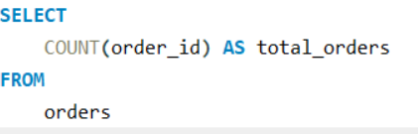

Retrieve the total number of orders placed.

Slide 7
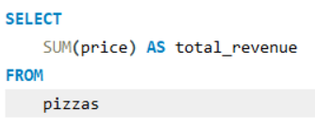

Calculate the total revenue generated from pizza sales.

Slide 8
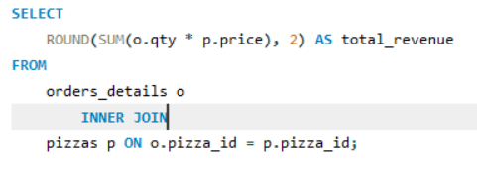

calculate the total revenue quantity wise

Slide 9
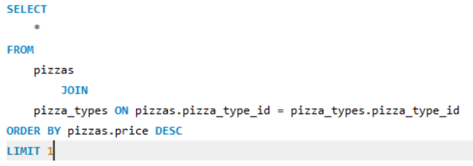
Identify the highest-priced pizza.

Slide 10
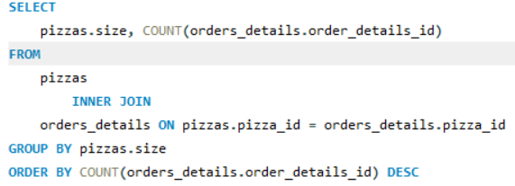
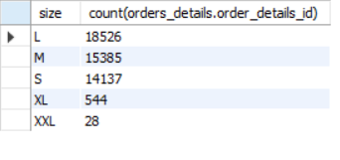
Identify the most common pizza size ordered.

Slide 11
1. advance Analysis

Slide 12
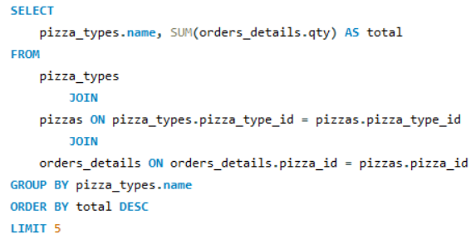
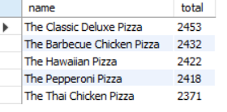
List the top 5 most ordered pizza types along with their quantities.

Slide 13
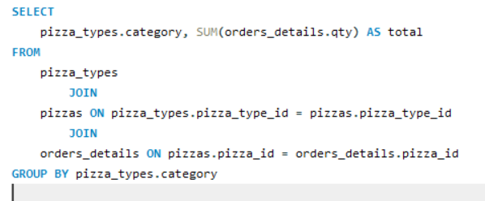
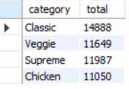
Join the necessary tables to find the total quantity of each pizza category ordered.

Slide 14
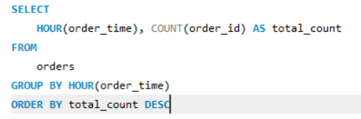
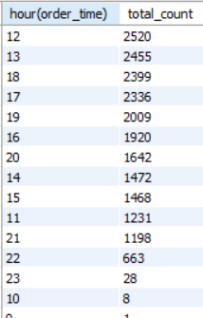
Determine the distribution of orders by hour of the day.

Slide 15
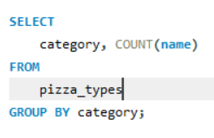
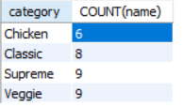
Join relevant tables to find the category-wise distribution of pizzas.

Slide 16
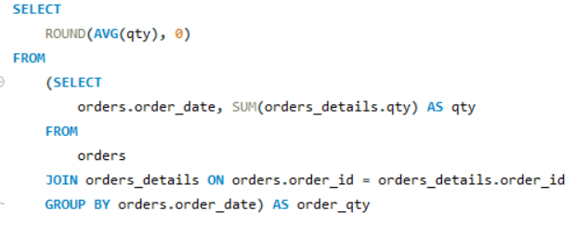

Group the orders by date and calculate the average number of pizzas ordered per day.

Slide 17
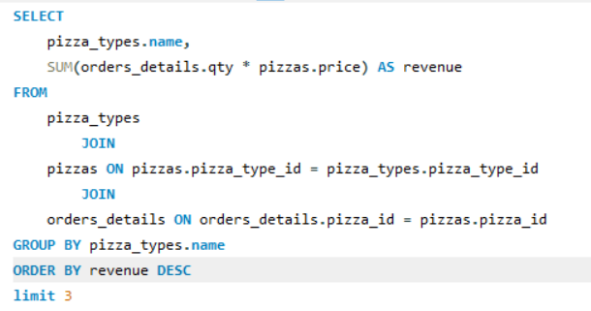

Determine the top 3 most ordered pizza types based on revenue.

Slide 18
Thank You

